Slide 1


Accounting and Finance ATAR
Year 11
Principles & Conventions underlying Financial Reports

Slide 2

Principles & Conventions underlying Financial Reports
Accounting terminology is defined in the Conceptual Framework for the Preparation and Presentation of Financial Statements (the Conceptual Framework).
Accounting conventions and principles underpin financial accounting in Australia. They are the basic rules of accounting.
When the accounting conventions and principles are followed it is possible to compare different businesses and make informed economic decisions.

Slide 3

The Conceptual Framework for the Preparation and Presentation of Financial Statements
Known as the “Conceptual Framework”
It sets out the concepts that underlie the preparation and presentation of financial reports for external users.
It deals with:
objectives of financial reports;
assumptions underlying financial reports;
qualitative characteristics of financial reports;
elements of financial reports; and
recognition criteria for the elements of financial statements.

Slide 4
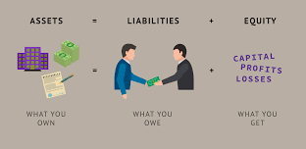
Assets, Liabilities & Equity

Slide 5
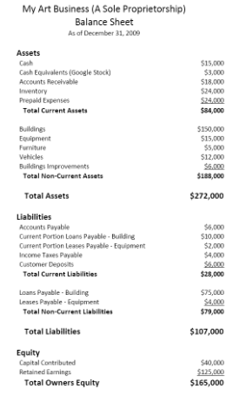
The Balance Sheet
A Balance Sheet is made up of:
assets
liabilities and
equity.
It is a snapshot of a business at a particular
point in time.

Slide 6
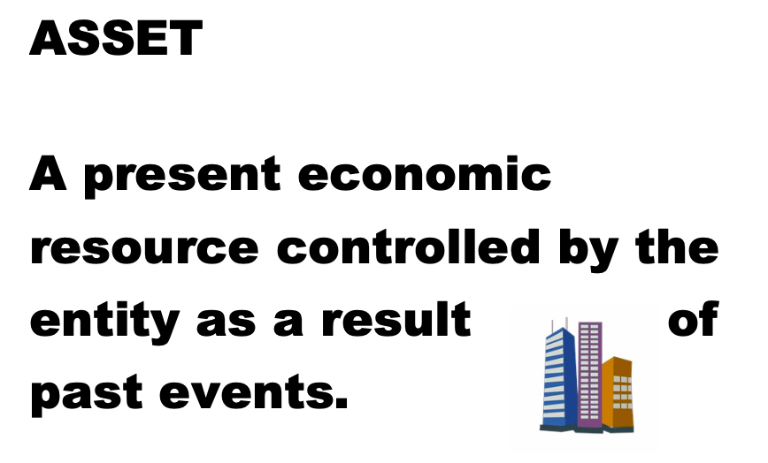
Definition from the Framework for the Preparation and Presentation of Financial Statements

Slide 7

An Asset
An asset is a resource controlled by the entity (business).
Examples include:
cash
motor vehicles
office equipment
a debt owed to the business
trading stock

Slide 8
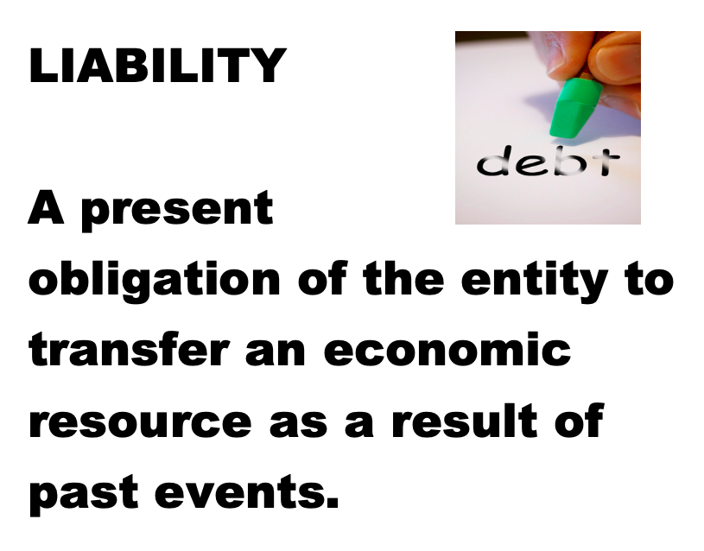
Definition from the Framework for the Preparation and Presentation of Financial Statements

Slide 9

A Liability
A liability is money or a service owed to others.
Examples include:
tax owed to the ATO
wages payable
superannuation payable
a debt owed to another business
a bank loan

Slide 10
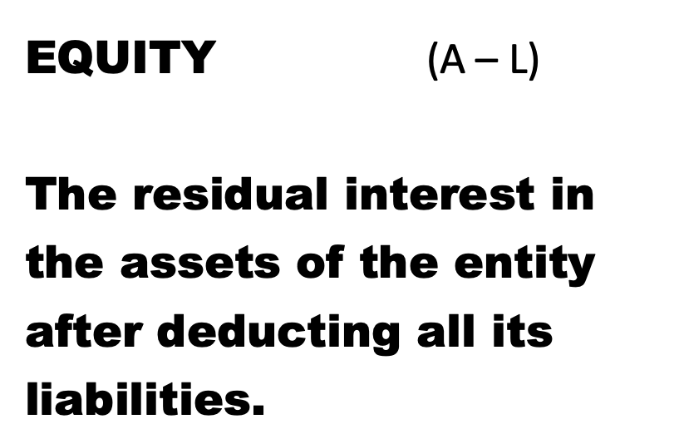
Definition from the Framework for the Preparation and Presentation of Financial Statements

Slide 11
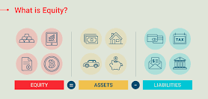
Equity
Equity is the remaining interest in the assets of the business after deductions of its liabilities, E = A - L
Equity is the amount the business owes
the owners. It is the owners’ investment
in the business.

Slide 12
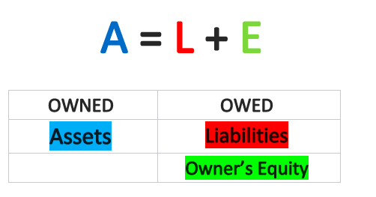
The Accounting Equation
The simplified accounting equation show a snapshot of a business at a specific point in term.
Eq = A - L or
A = L + Eq or
L = A – Eq
Where A = Assets, L = Liabilities and Eq = Equity.

Slide 13
Questions:
Define an ‘asset’, using examples.
Define a ‘liability’, using examples.
Define ‘equity’.
Classify the following as an Asset, Liability or Equity:
Cash in the till
Cash in the bank account
Mortgage
Car loan
Stock
Furniture
Accounts receivable
Accounts payable
Owner’s interest in the business
Drawings
Motor vehicle
Wages payable

Slide 14
Questions:
Define an ‘asset’, using examples. A present economic resource controlled by the entity as a result of past events. For example; cash at the bank, accounts receivable and stock (examples will vary).
Define a ‘liability’, using examples. A present obligation of the entity to transfer an economic resource as a result of past events. For example; accounts payable, car loan, wages payable (examples will vary).
3. Define ‘equity’. The residual interest in the assets of the entity after deducting all its
liabilities.
4. Classify the following as an Asset, Liability or Equity:
Cash in the till - Asset
Cash in the bank account - Asset
Mortgage - Liability
Car loan - Liability
Stock - Asset
Furniture - Asset
Accounts receivable - Asset
Accounts payable - Liability
Owner’s interest in the business - Equity
Drawings - Equity
Motor vehicle - Asset
Wages payable - Liability

Slide 15
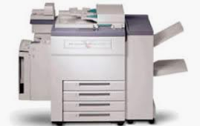
Classification of Assets & Liabilities
The balance sheet classifies assets as two specific types, either:
current assets or
non-current assets.
Current Assets
Current Assets are assets the business expects to consume (use) or turn into cash within 12 months or less.
Examples:
cash at bank
accounts receivable
stock (inventory)
Non- Current Assets
Non-current Assets are assets the business expects to have the use of for a period longer than 12 months.
Examples:
vehicles
machinery
land and buildings

Slide 16
Classification of Assets & Liabilities
The balance sheet classifies liabilities as two specific types, either:
current liabilities or
non-current liabilities.
Current Liabilities
Current liabilities are amounts owed that will be settled within 12 months or less.
Examples:
bank overdraft
accounts payable
GST payable to ATO
Non- Current Liabilities
Non-current liabilities are amounts owed that will be settled in more than 12 months.
Examples:
long-term loan (eg. 10 years)
mortgage
car loan

Slide 17
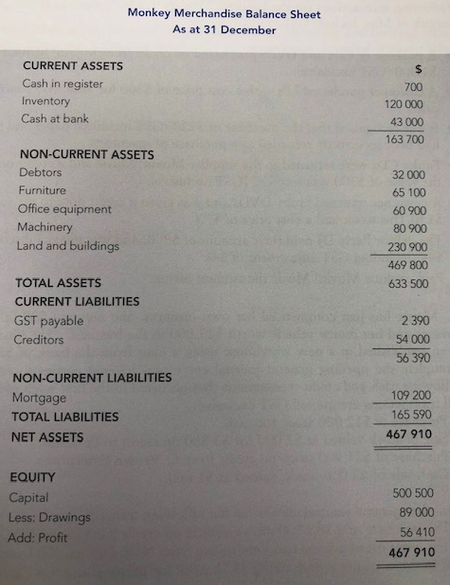
An example of a classified Balance Sheet showing:
Assets (current & non-current)
Liabilities (current & non-current)
Equity
NB:
Drawings: is the amount the owner has withdrawn from the business.
Profit: this is income less revenue. If there is a loss there will be brackets around the number.
Source: A & F WACE Study Guide: Academic Associates

Slide 18
Questions:
1. What elements make up the balance sheet?
2. What is the difference between a current liability and a non-current liability?
3. Classify the following as a current asset, non-current asset, current liability, non-current liability or equity.
cash at bank
start up capital
furniture
mortgage
accounts payable
accounts receivable
long-term loan (8 years)
short term loan (8 months)

Slide 19
Questions:
1. What elements make up the balance sheet? Assets, liabilities and equity.
2. What is the difference between a current liability and a non-current liability? A current liability will be settled with 12 months and non-current liability will be settled in more than 12 months.
3. Classify the following as a current asset, non-current asset, current liability, non-current liability or equity.
cash at bank – current asset
start up capital - equity
Furniture – non-current asset
Mortgage – non-current liability
accounts payable – current liability
accounts receivable – current asset
long-term loan (8 years) - non-current liability
short term loan (8 months) – current liability

Slide 20

Income & Expenses

Slide 21
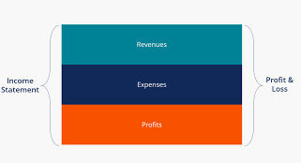
The Income Statement
The Income Statement is a report which details the various income and expenses incurred in an accounting period in order to calculate the profit and loss a business has made in the accounting period.
Basically: Profit (loss) = Income – Expenses
The way in which a business defines income and expenses is important as it determines how the final profit figure is reached.

Slide 22
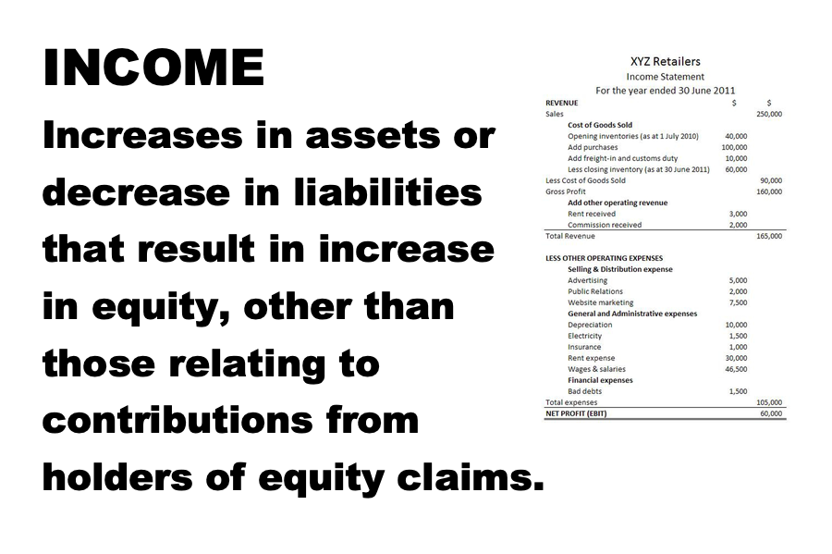
Definition from the Framework for the Preparation and Presentation of Financial Statements

Slide 23

Income
Income: Increases in assets or decrease in liabilities that result in increase in equity, other than those relating to contributions from holders of equity claims.
Breaking the income definition down:
‘’increases in assets”
For example, if a builder issued an invoice to a customer that was to be paid by the end of the month, accounts receivable (asset) would increase.
“decreases in liabilities”
For example, if a discount on a bill is received, less is owed to the creditor, thus reducing the amount of the liability.

Slide 24

Income
Income: Increases in assets or decrease in liabilities that result in increase in equity, other than those relating to contributions from holders of equity claims.
Breaking the income definition down:
’that results in increase in equity’ -
Any income transaction will result in an increase in equity. Because; Assets = Liabilities + Equity (A = L + E). During this course we will discover how an increase in income leads to an increase in equity.
‘other than those relating to contributions from equity participants’ –
For example if the owner of the business contributes $1,000 cash this will not be regarded as income even though equity is increased. (Accounting entity assumption.)

Slide 25

Income
Income: Increases in assets or decrease in liabilities that result in increase in equity, other than those relating to contributions from holders of equity claims.
Income examples:
Fees or sales for services, eg. the sale of cakes at a bakery.
Sales of inventory, eg. the sale of wood by a hardware store.
The use of assets, eg. interest received on funds in a bank account (this income is a gain).
The sale of assets for more than the written down value, eg. selling land for more than it was purchased for (this income is a gain).
A discount received for a payment of a debt before a due date.

Slide 26
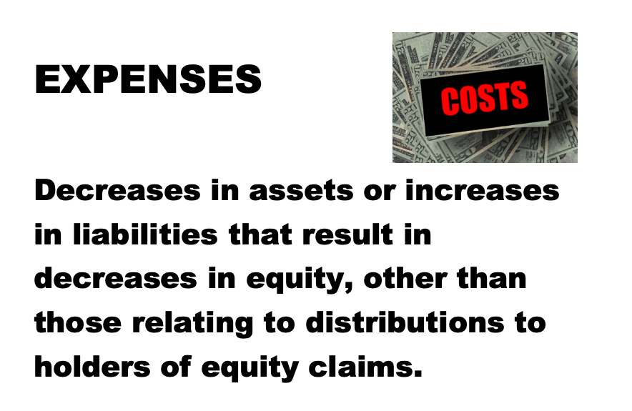
Definition from the Framework for the Preparation and Presentation of Financial Statements

Slide 27
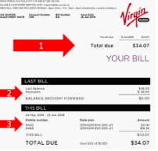
Expenses
Expenses: Decreases in assets or increases in liabilities that result in decreases in equity, other than those relating to distributions to holders of equity claims.
Breaking the expense definition down:
”decrease in assets”
For example, if a $300 phone bill is paid, the cash in the bank (asset) has decreased by $300.
“increase in liabilities”
For example, if a new bill has come in that will be paid at the end of the month, accounts payable (liability) increases.

Slide 28
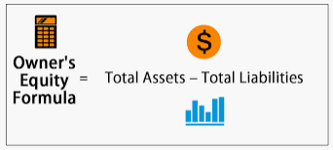
Expenses
Expenses: Decreases in assets or increases in liabilities that result in decreases in equity, other than those relating to distributions to holders of equity claims.
Breaking the expense definition down:
’that results in decreases in equity’ -
Any expense transaction will result in a decrease in equity. Because; Equity = Assets – Liability (E = A - L). During this course we will discover how an increase in liabilities leads to a decrease in equity.
‘other than those relating to contributions from equity participants’ –
For example if the owner of the business withdraws $1,000 cash this will not be regarded as an expense even though equity is decreased. (Accounting entity assumption.)

Slide 29

Elements of financial statements as per The Framework
Balance Sheet elements:
Assets
Liabilities
Equity
Income Statement elements:
Income
Expenses

Slide 30
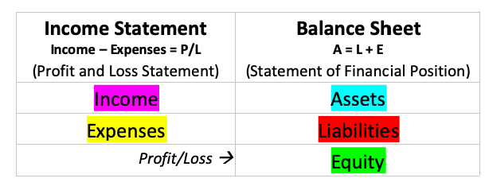
The 5 elements of accounting are:

Slide 31

Questions:
Calculate whether a profit or loss has been made:
Which of these transactions is an expense?
Leo Slider paid off a $2,000 loan.
Big Electrics received and paid a telephone bill for $300.
Harry’s Pets took out a loan for $60,000.
3. Which of these transactions is income?
Cherry Kipsom mowed some lawns and was paid $90.
Bert Bernie bought a computer for $2,500.
Lily Brawl took out a loan for $10,000.
Jim Pratt sold $3,000 worth of merchandise.

Slide 32

Questions:
Calculate whether a profit or loss has been made:
Which of these transactions is an expense?
Leo Slider paid off a $2,000 loan. Liability
Big Electrics received and paid a telephone a bill for $300. Expense
Harry’s Pets took out a loan for $60,000. Liability
3. Which of these transactions is income?
Cherry Kipsom mowed some lawns and was paid $90. Income
Bert Bernie bought a computer for $2,500. Asset
Lily Brawl took out a loan for $10,000. Liability
Jim Pratt sold $3,000 worth of merchandise. Income

Slide 33
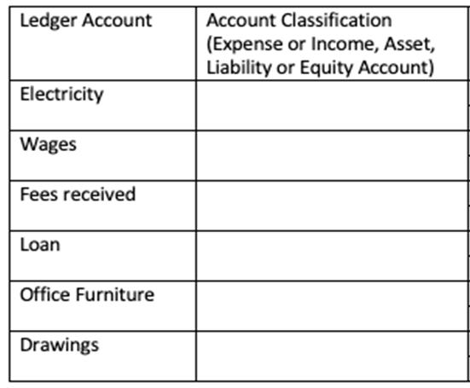
Questions:
1. Classify the following ledger accounts as an Asset, Liability, Income or Expense:

Slide 34
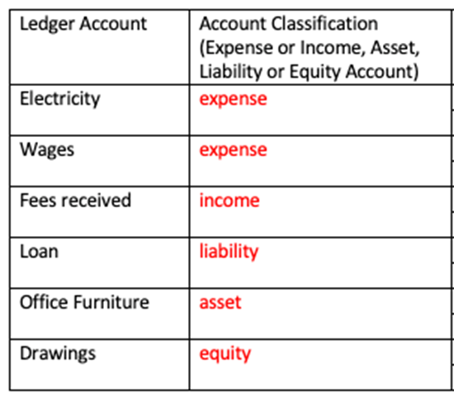
Solution:

Slide 35
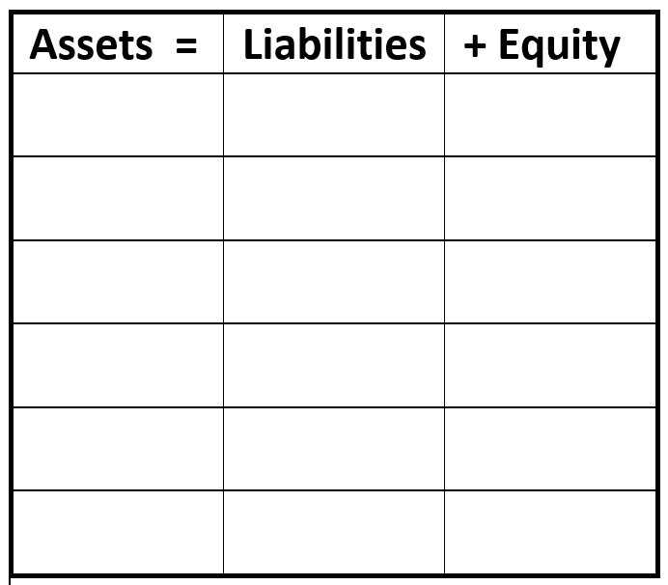
The effect of transactions on the Accounting Equation
The owner contributes $10,000 to the business.
Pays rent of $2,000
Gets a bank loan of $6,000
Buys computer equipment of $4,000 cash
Delivers a service of $5,000
Withdraws $1,000

Slide 36
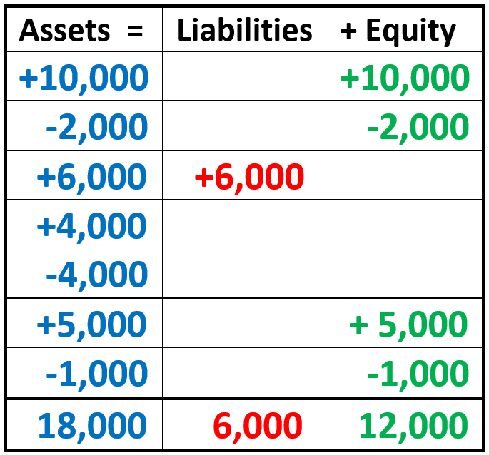
The effect of transactions on the Accounting Equation
The owner contributes $10,000 to the business.
Pays rent of $2,000
Gets a bank loan of $6,000
Buys computer equipment of $4,000 cash
Delivers a service of $5,000
Withdraws $1,000
→ New Equation

Slide 37

Double Entry Accounting
Every transaction affects two business accounts, or two sides of the ledger, by the same dollar amount. Two entries are made – this is double entry accounting.
A transaction is a financial exchange that affects the elements of the accounting equation.
For example, if a business pays a $300 rent bill, the bank account will decrease by $300 while the rent expense account will increase by $300.

Slide 38
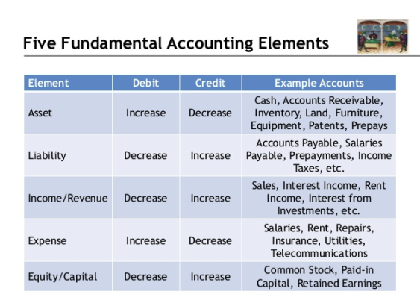
What do the terms ‘debit’ and ‘credit’ mean?
With double entry accounting each transaction has a debit and a credit. The total of all entries must equal that total of all credit entries for each transaction.

Slide 39

Why Double Entry?
Equalising entries allows for a mathematical check for accuracy
Both aspects of a transaction are recorded
The risk of fraud is decreased as a balance check occurs
The owner’s interest in the business is seen separately and the concept of capital is developed through the proprietorship account
It allows for the calculation of profit or loss
A classification systems is created
It is easy to readily determine the financial position

Slide 40

Double Entry in Review
The system of accounting where every transaction affects two or more parts of the accounting equation
The dual effect of every transaction is recorded in appropriate accounts (at least 2 different accounts).
Double entry is based on the accounting equation Assets = Liabilities + Equity, in which each entry is recorded to maintain the relationship

Slide 41
Double Entry in Review (cont)
Every transaction is recorded with equal debits and credits – the sum of both must equal
For example, if a business buys a motor vehicle with cash for $3,300, the motor vehicle asset is debited $3,000, GST credit is debited $300, and the cash account is credited $3,300.

Slide 42

Objectives of Financial Statements
The objective of financial reports is to provide information about the entities:
financial position,
financial performance, and
cash flows
It is useful to a wide range of users in making economic decisions

Slide 43

Objectives of Financial Statements continued
Financial reports also show the results of the stewardship of management, or the accountability of management for the resources entrusted to it.
They meet the common needs of a wide range of users:
To provide information to assist users to make decisions about the allocation of scarce resources

Slide 44

Performance
Information about the performance of an entity, in particular its profitability, is required in order to assess potential changes in the economic resources that it is likely to control in the future.
Information about performance is primarily provided in an income statement
Profit is frequently used as a measure of performance or as the basis for other measures, such as return on investment or earnings per share.

Slide 45

Financial Position
The financial position of an entity is affected by:
the economic resources it controls,
its financial structure,
its liquidity and solvency, and
its capacity to adapt to changes in the environment in which it operates.
Information about financial position is primarily provided in a balance sheet.

Slide 46
Sources include:
A & F WACE Study Guide: Academic Associates
E. Criddle & K. Kania, (2014) Accounting and Finance A resource for Year 11 ATAR/Year 12 General, Cottesloe: Impact Publishing

